Slide 1
Distinguished Lecture in Social Science and Art
Introduction
(Chapter 1 & Syllabus)
Bobir Muratov

Slide 2
What are Social Science, Humanities, and Arts?

Slide 3
Social Science, Humanities, and Arts
Social science is the study of people: as individuals, communities and societies; their behaviors and interactions with each other and with their built, technological and natural environments. Social science seeks to understand the evolving human systems across our increasingly complex world and how our planet can be more sustainably managed.
Anthropology, Economics, Political Science, Sociology, Social Psychology
Humanities help us understand human history, culture, communities, and beliefs. In the humanities, we explore how people have created their world and how they in turn have been formed by the world around them. The humanities are critical, speculative, and reflective. They help us to understand our lives and the lives of others.
History, Literature, Philosophy, Religion, Language, The Arts
The arts is modes of expression that use skill or imagination in the creation of aesthetic objects, environments, or experiences that can be shared with others.

Slide 4
Why do we need them?
Why do you need this subject?

Slide 5
Course Description
The aim of this course is to introduce computer science and engineering students to critical thinking skills and contemporary issues and debates in social sciences, humanities, arts, and technology. By engaging in these discussions, students will be able broaden their horizons beyond their major fields, build critical reflection skills, and foster creativity and ethical awareness.

Slide 6
Topics
Weekly schedule
Week | Class Details
1 | Introduction, Chapter 1. Critical Thinking: Why it’s Important
2 | Chapter 2. Reason & Emotion
3 | Chapter 4. Knowledge, Evidence & Errors in Thinking
4 | Chapter 5. Informal Fallacies
5 | Chapter 6. Recognizing, Analyzing & Constructing Arguments
6 | Chapter 11. Marketing, Mass Media, Politics
7 | Chapter 12. Science
8 | Midterm - offline
9 | Social Science Lecture 1
10 | Social Science Lecture 2
11 | Social Science Lecture 3
12 | Debates - offline on Saturday
13 | Debates - offline on Saturday
14 | Debates - offline on Saturday
15 | Final week - no exam

Slide 7
Grading
Attendance (20%) – watching weekly lectures and videos
Quiz (20%) – related to lecture materials
Midterm (30%) – based on Critical Thinking chapters (weeks 1-7)
Debate (30%) – group project, will be conducted in the last month of semester. Details will follow.
Pass mark – 40%
F for missing more than 25% of online lectures (4th miss – F)
No excuses as this is an online class

Slide 8
Communication
Office: B410
Office hours: TBA after the timetable fix
E-class: message
Email: b.muratov@inha.uz
Curator
Teaching Assistant: Firdavs Sobirov, f.sobirov@inha.uz
Telegram?
LinkedIn?

Slide 9
Break

Slide 10
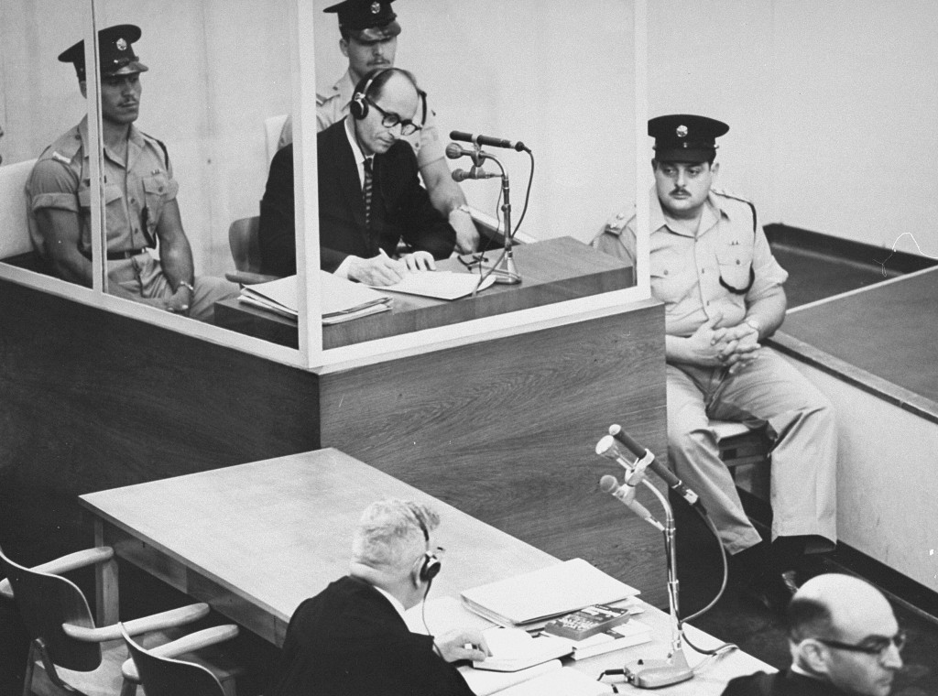
Nazi Criminal – Adolf Eichmann Trial
Was he an inhuman monster or just following the orders?

Slide 11
The Milgram Experiment
https://www.youtube.com/watch?v=vuMt8b4UrcI
How could this happen?
Were the results some sort of deviation?

Slide 12
The Stanford Prison Experiment
https://www.youtube.com/watch?v=iXv91xFipLM&t=144s
Many people will uncritically follow the commands of those in authority

Slide 13
What is Critical Thinking?

Slide 14
What is Critical Thinking?
Critical thinking – a collection of skills we use every day that are necessary for our full intellectual and personal development
It requires learning how to think rather than what to think
Logic – the study of the methods and principles used to distinguish correct or good arguments from poor arguments
Opinion – a belief based solely on personal feelings rather than on reason or facts

Slide 15
Cognitive Development in University Students
Stage 1: Dualism – there are right and wrong answers. Authorities know the right answers
Stage 2: Relativism – when the authorities don’t have the right answers, everyone has a right to his/her opinion; there are no right and wrong answers
Stage 3: Commitment – I should no just blindly follow or oppose authority

Slide 16
Characteristics of a Good Critical Thinker?

Slide 17
Characteristics of a Good Critical Thinker
Analytical skills
Effective communication
Research and inquiry skills
Flexibility and tolerance to ambiguity
Open-minded skepticism (method of doubt – Descartes)
Creative problem solving
Attentive, mindful, and curious
Collaborative learning

Slide 18
Barriers to Critical Thinking?

Slide 19
Barriers to Critical Thinking
Three-Tier Model of Thinking
Experience
Interpretation
Analysis

Slide 20
Barriers to Critical Thinking
Resistance – the habitual use of immature defense mechanisms when our worldviews are challenged
Avoidance
Anger
Clichés
Denial
Ignorance
Conformity
Struggling
Distractions

Slide 21
Barriers to Critical Thinking
Narrow-mindedness – rigid beliefs that interfere with critical analysis of our worldviews
Absolutism
Fear of challenge
Egocentrism
Ethnocentrism
Anthropocentrism

Slide 22
Barriers to Critical Thinking
Rationalization and doublethink
Cognitive and social dissonance
Stress

Slide 23
Thanks

